Slide 1
AZ-304: Microsoft Azure Architect Design

Slide 2
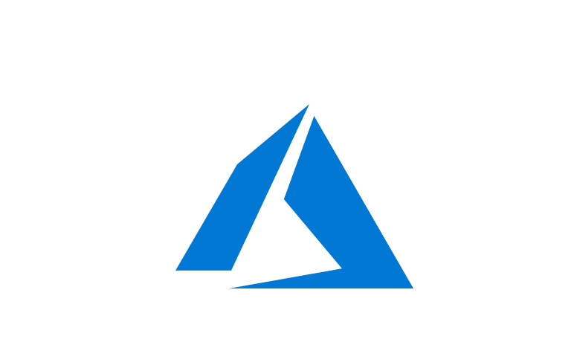
Course Outline
Module 1: Design a Compute Solution
Module 2: Design a Network Solution
Module 3: Design for Migration
Module 4: Design Authentication and Authorization
Module 5: Design Governance
Module 6: Design a Solution for Databases
Module 7: Select an Appropriate Storage Account
Module 8: Design Data Integration
Module 9: Design a Solution for Logging and Monitoring
Module 10: Design a Solution for Backup and Recovery
Module 11: Design for High Availability
Module 12: Design for Cost Optimization
Module 13: Design an Application Architecture
Module 14: Design Security for Applications
NOTE: The module order listed above aligns with the learning objectives described on the AZ-304: Microsoft Azure Architect Design certification page.

Slide 3
Module 12: Design for Cost Optimization
Solutions for Cost Management and Cost Reduction

Slide 4
Learning Objectives
Recommend Solutions for Cost Management
Recommendations for Minimizing Costs
Cost Optimization Checklists
Module Review Questions

Slide 5
Recommend Solutions for Cost Management

Slide 6
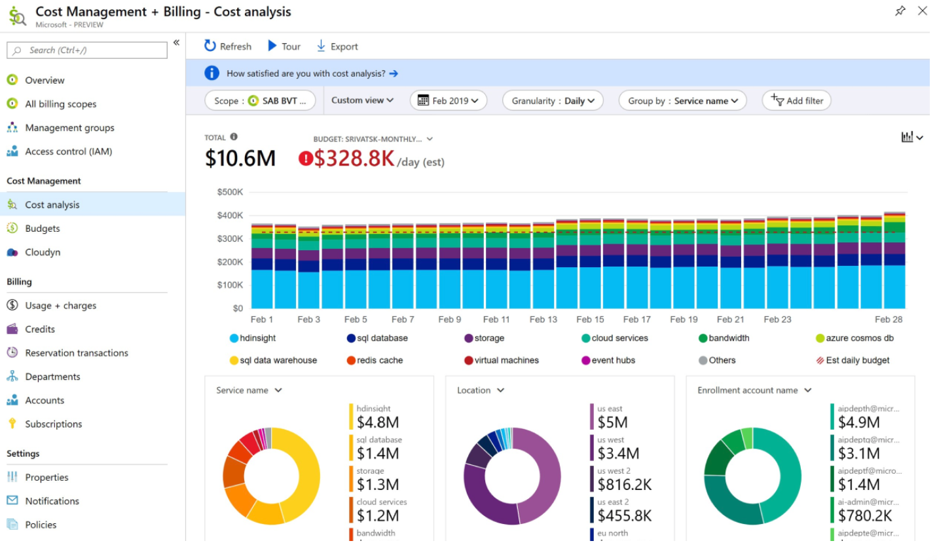
Azure Cost Management
Cost Management displays organizational cost and usage patterns
Show usage-based costs consumed by Azure services and third-party Marketplace offerings
Conduct cost analysis
Create a budget
Review recommendations
Export the data

Slide 7
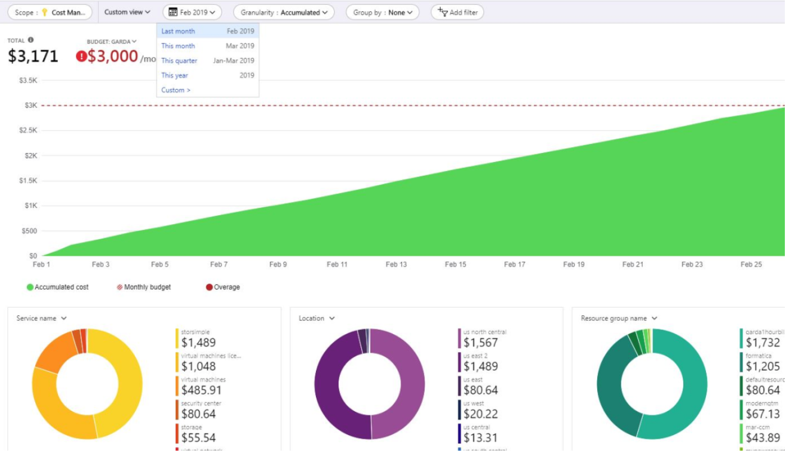
Optimize with Azure Cost Management
Prepare with the proper tools for success
Be accountable for costs
Take action to optimize spending
Three key groups must be aligned to successfully manage costs
Finance
Managers
App team(s)
Notes:
Three key groups must be aligned to successfully manage costs.
Finance: Responsible for approving budget requests across the organization based on cloud spending forecasts. They pay the corresponding bill and assign costs to various teams to drive accountability.
Managers: Business decision makers need to understand cloud spending to find the best spending results.
App team(s): Engineers managing cloud resources and developing service. They need the flexibility to deliver the most value in their defined budgets.
https://docs.microsoft.com/en-us/azure/cost-management-billing/costs/cost-mgt-best-practices

Slide 8

Cost Design Principles
What business problem am I trying to solve?
What usage patterns do I expect from my resources?
Visibility
Accountability
Optimization
Iteration
Notes:
Planning (Questions):
What business problem am I solving?
What usage patterns do I expect from my resources?
Visibility
Cost Management identifies Azure costs and who’s responsible for the they spent.
Azure services can find resources that are underused, remove waste, and maximize cost-saving opportunities… and who is doing the spending.
Accountability
Attribute costs to make sure people responsible are accountable for team spending.
Organize resources to maximize insight into cost attribution.
Optimization
Based on the findings gathered through planning and cost visibility, consider purchase and licensing optimizations.
Iteration
Everyone must engage in the cost management lifecycle and efforts to optimize costs.
Be rigorous with iteration make it a key pillar of cloud governance.
https://docs.microsoft.com/en-us/azure/cost-management-billing/costs/cost-mgt-best-practices#key-principles

Slide 9
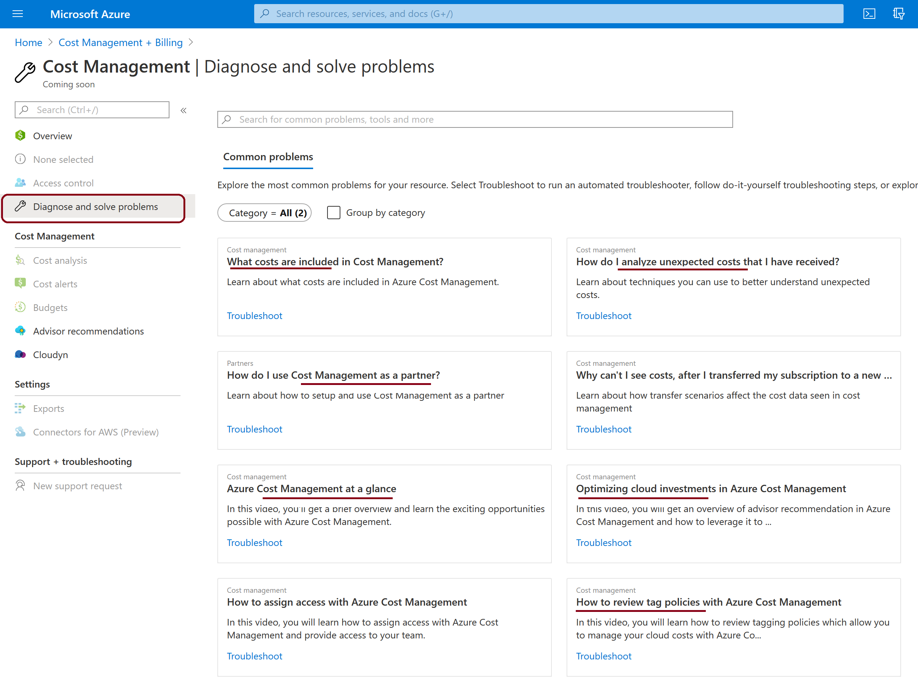
Design with Cost in Mind
Estimated costs for the current month
Investigate anomalies
Invoice reconciliation
Internal chargeback
Notes:
Common questions for cost analysis.
Estimated costs for the current month – How much have I incurred so far this month? Will I stay under my budget?
Investigate anomalies – Do routine checks to make sure that costs stay within a reasonable range of normal usage. What are the trends? Are there any outliers?
Invoice reconciliation - Is my latest invoiced cost more than the previous month? How did spending habits change month-over-month?
Internal chargeback - Now that I know how much I'm being charged… how should those charges be broken down for my organization?
https://docs.microsoft.com/en-us/azure/cost-management-billing/costs/cost-mgt-best-practices#analyze-and-manage-your-costs

Slide 10
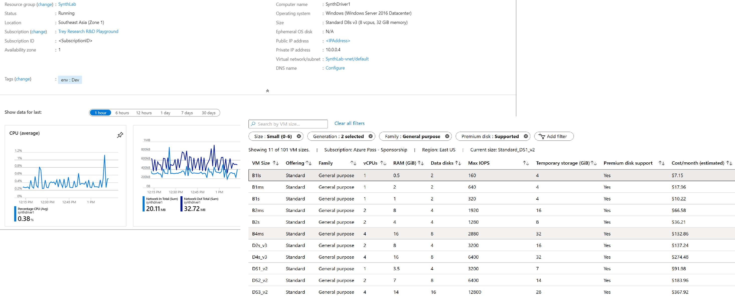
Demonstration - Optimize Costs from Recommendations
This demonstration walks shows you how to identify underutilized Azure resources and take action to reduce costs
View cost optimization recommendations to view potential usage inefficiencies
Act on a recommendation to resize a virtual machine to a more cost-effective option
Verify the action to ensure that the virtual machine was successfully resized
Subscription
Resource group

Slide 11
Recommendations for Minimizing Costs

Slide 12
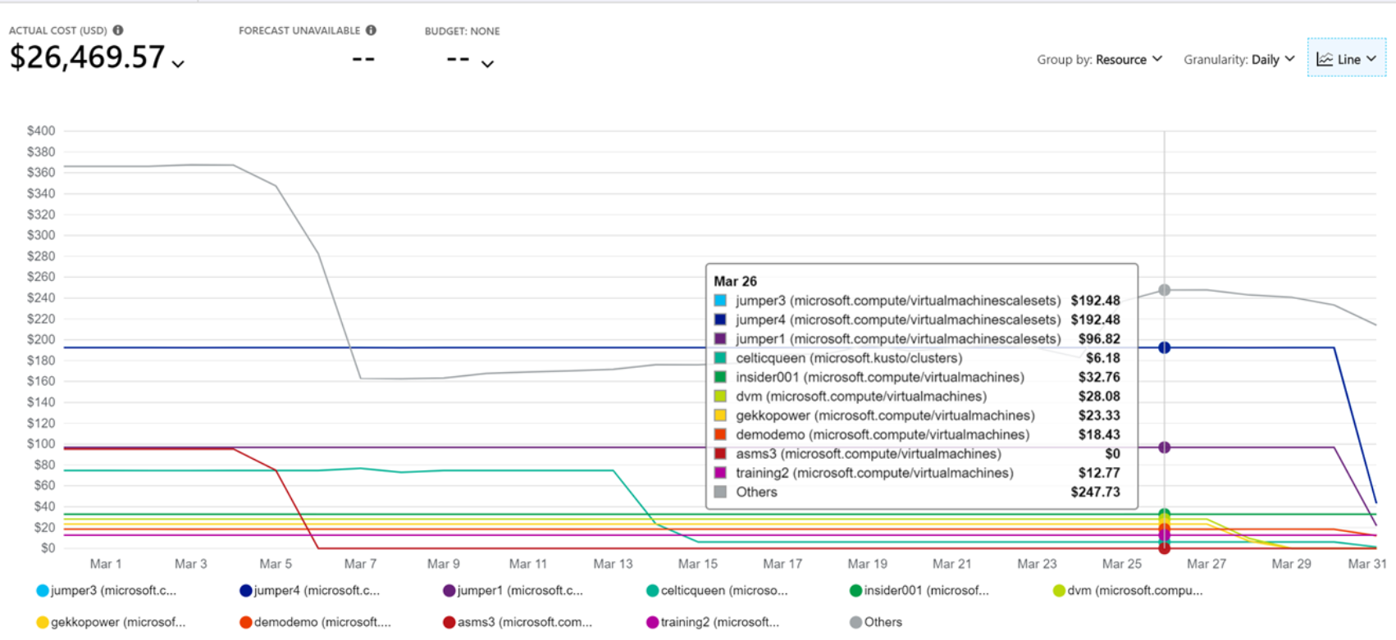
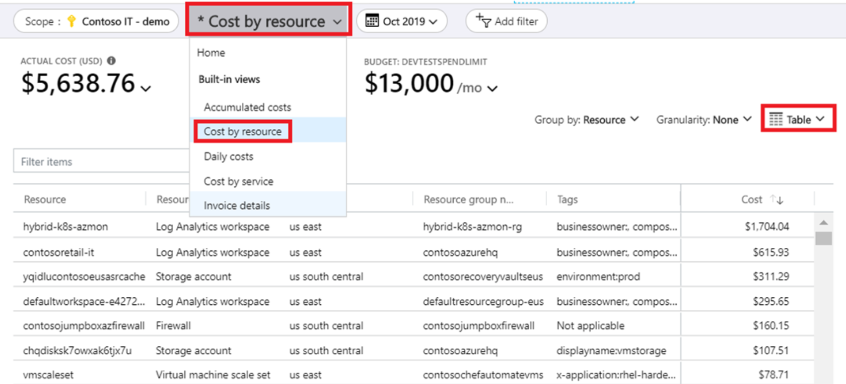
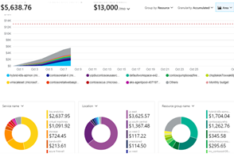
View Cost Breakdown by Azure Service
1
Review Invoiced Charges in Cost Analysis
2
View Cost Breakdown by Azure Resource
3
View Cost Breakdown by Selected Dimensions
Notes:
Review Invoiced Charges in Cost Analysis
To view invoice details in the Azure portal, navigate to Cost analysis for the scope associated with the invoice that you're analyzing.
View Cost Breakdown by Azure Resource
Services are built with Azure resources. Reviewing costs based on resources can help you quickly identify the primary cost contributors.
View Cost Breakdown by Selected Dimensions
Dimensions allow you to organize costs based on various metadata values shown in charges. For example, you could group costs by location.

Slide 13
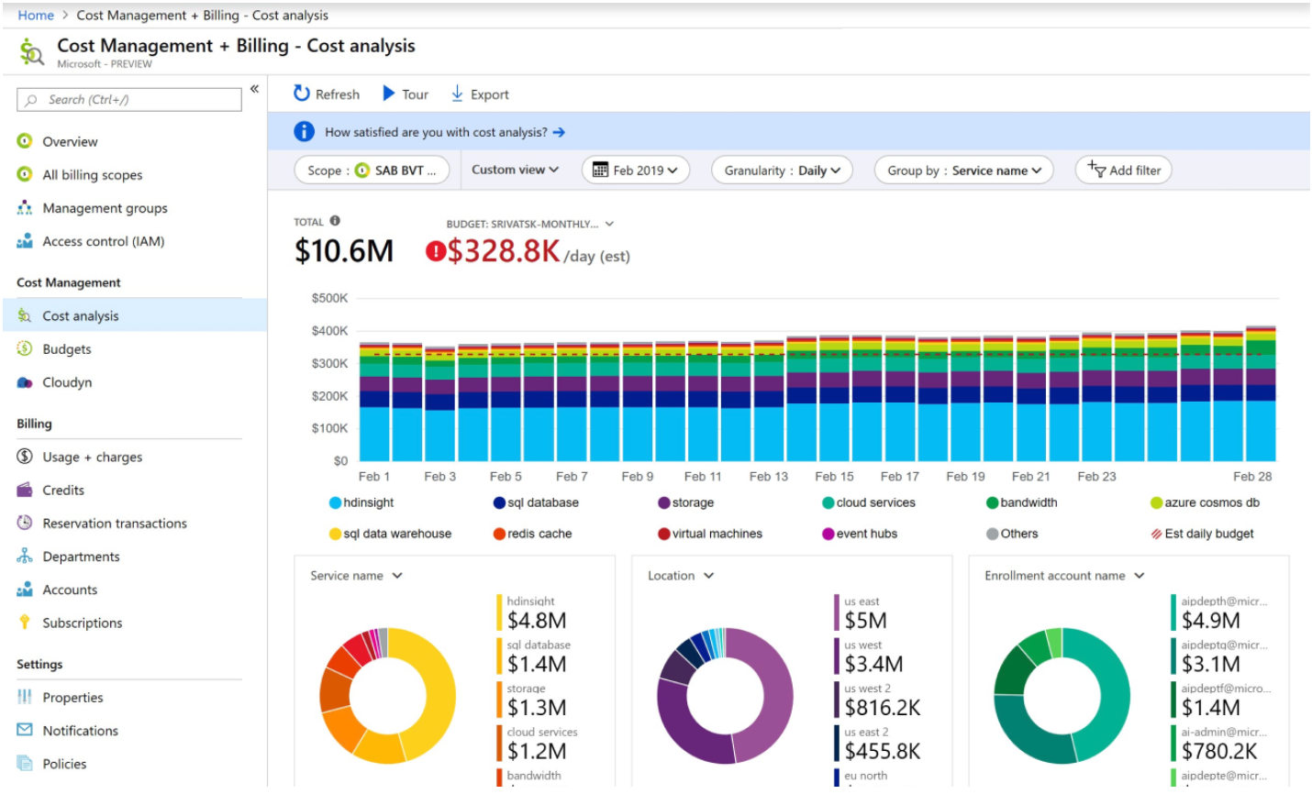
View Costs by Day or Month
Monthly or Daily: Cost Management + Billing > Cost Management > Cost Analysis

Slide 14
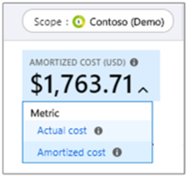
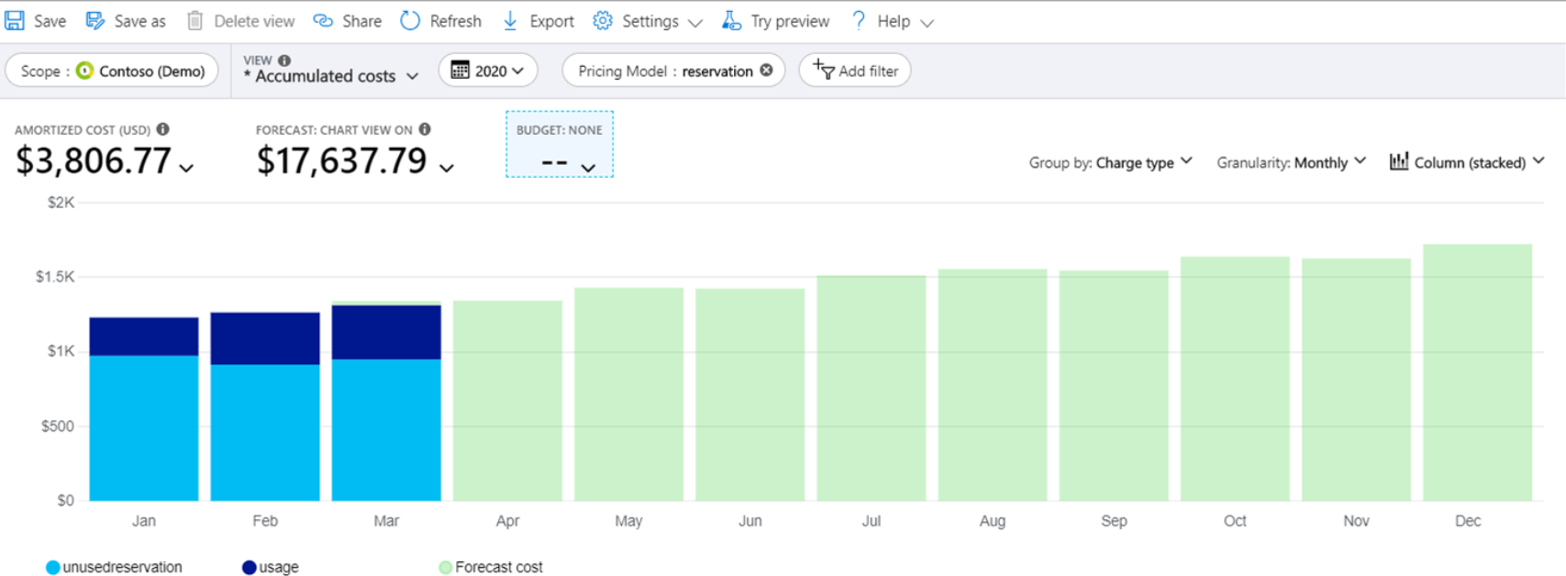
View Reservation Charges
Actual cost – The purchase as it appears on the bill
Amortized cost - Amortized cost over the duration of the reservation term
After purchasing a reservation, it's important to track utilization
Notes:
Actual cost - Shows the purchase as it appears on the bill—it doesn't show a reservation cost for other months of the year.
Amortized cost - Shows a reservation purchase split as an amortized cost over the duration of the reservation term. For example, see cost attributed to each VM that received the reservation benefit.

Slide 15
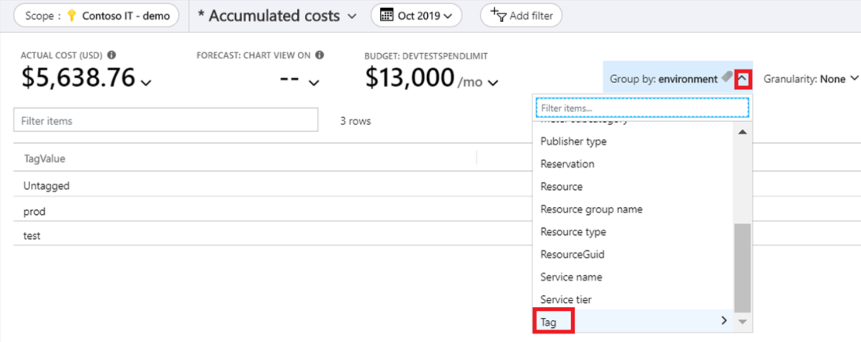
View Costs for a Specific Tag
Support for tags applies to usage reported after is tag was applied to the resource
Cost Management + Billing > Cost Management > Cost analysis
Select Group by for the tag

Slide 16
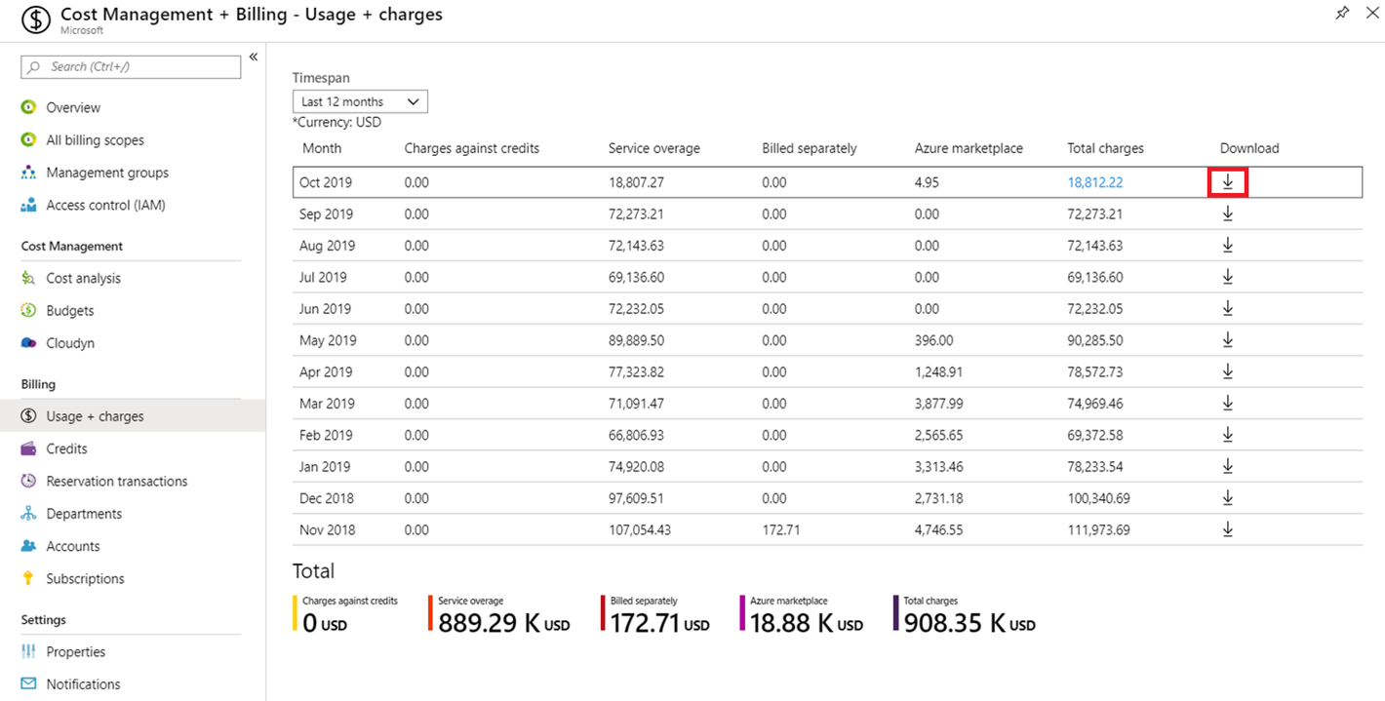
Download Usage Details
Cost Management + Billing > Billing > Usage + charges
Select the line item to download from and click the download symbol

Slide 17
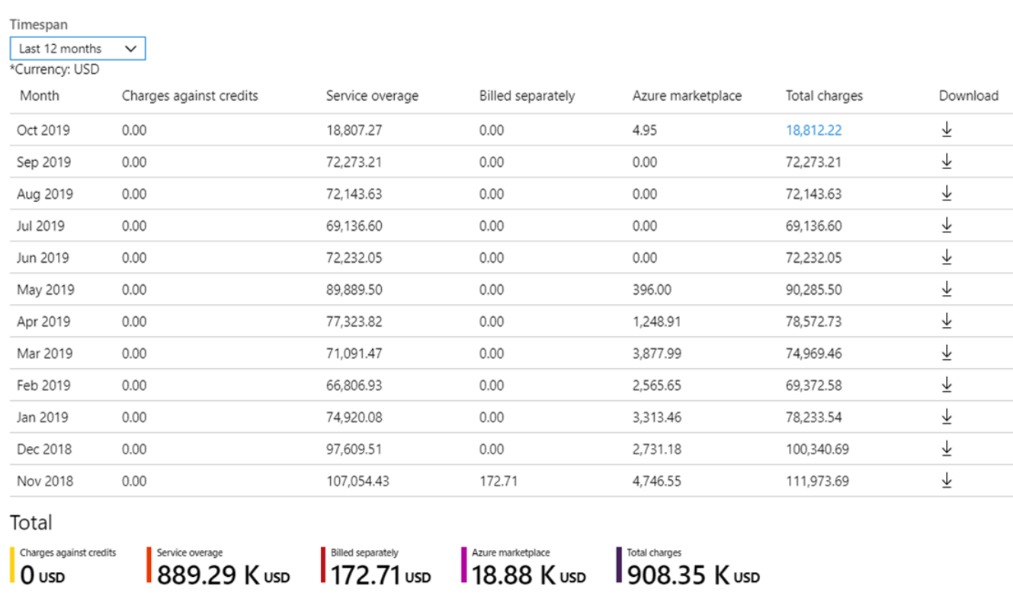
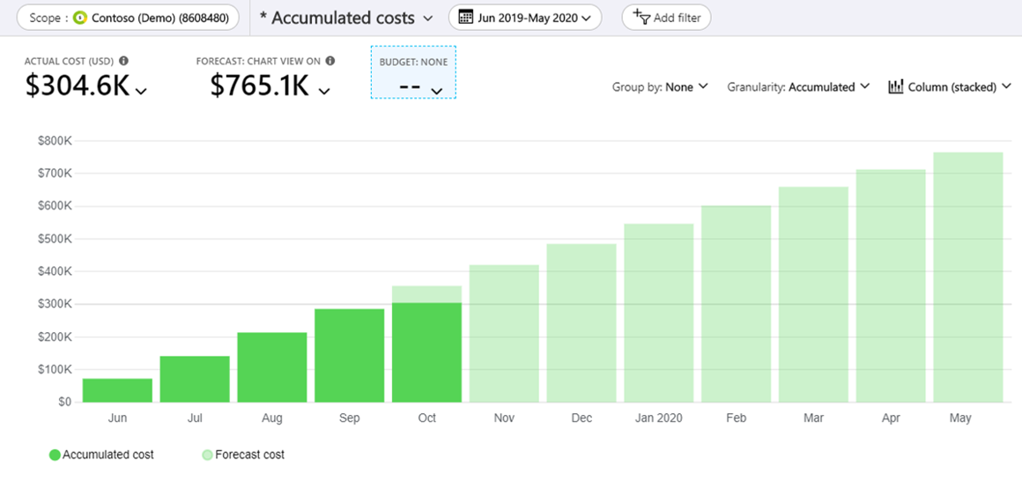
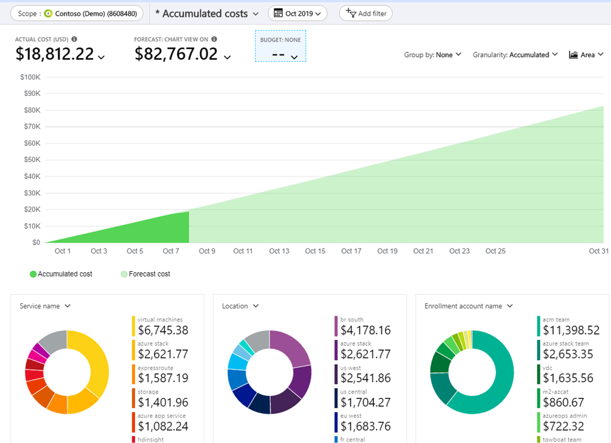
View Monthly EA Cost Breakdown
View Monthly EA Cost Breakdown
Navigate to Cost Management + Billing > Overview
Click Breakdown
View Enrollment Monthly Cost by Term
Navigate to Cost Management + Billing > Cost Management > Cost
Select your enrollment and set the enrollment term
View EA Enrollment Accumulated Costs
Navigate to Cost Management + Billing > Cost Management > Cost analysis
Select the enrollment and then view the current accumulated costs

Slide 18
Cost Optimization Checklists

Slide 19

Checklist - Design for Cost
Cost model
Capture clear requirements.
Estimate the initial cost.
Define policies for the cost constraints defined by the organization.
Identify shared assets.
Plan a governance strategy
Architecture
Check the cost of resources in various Azure geographic regions.
Choose a subscription that is appropriate for the workload.
Choose the right resources to handle the performance.
Compare consumption-based pricing with pre-provisioned cost.
Use proof-of-concept deployments.
Choose managed services when possible.

Slide 20


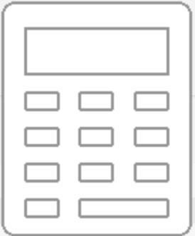
Checklist - Provisioning Cloud Resources to Optimize Cost
Use the Azure Pricing calculator to estimate the cost of SKU choices
Optimize Options by technology:
AI + Machine Learning
Big data analytics
Networking
Data stores

Slide 21
Checklist - Monitor Cost
Gather cost data from diverse sources to create reports
Use resource tag policies to build reports
Use RBAC built-in roles for cost.
Respond to alerts and have a response plan according to the constraints
Adopt both proactive and reactive approaches for cost reviews
Analyze the cost at all scopes
Detect anomalies
Use Visualization tools to analyze cost information
Notes:
https://docs.microsoft.com/en-us/azure/architecture/framework/cost/monitor-checklist

Slide 22

Checklist - Optimize Cost
Review the underutilized resources
Continuously act on the cost reviews
Use reserved instances on long running workloads
Use discount prices
Have a scale-in and scale-out policy
Reevaluate design choices
Choose the right storage tier
Choose the right data store
Choose Spot VMs for low priority workloads
Optimize data transfer
Reduce load on servers
Use managed services
Notes:
https://docs.microsoft.com/en-us/azure/architecture/framework/cost/optimize-checklist
https://docs.microsoft.com/en-us/assessments/

Slide 23
Module 12 Review Questions

Slide 24
Online Role-based training resources: Microsoft Learn https://docs.microsoft.com/en-us/learn/

Slide 25
Thank you.

